Slide 1

Advanced Big Data:
Distributed Databases
Dan Zaratsian
AI & Machine Learning Engineer @ Google
d.zaratsian@gmail.com
https://github.com/zaratsian

Slide 2


TOPICS
Session 1: Intro Big Data Architectures and Services
Session 2: SQL and NoSQL
Session 3: Spark ML
Session 4: Real-Time Streaming Analytics
Session 5: Serverless Technology
Session 6: Cloud Machine Learning and Deployments

Slide 3

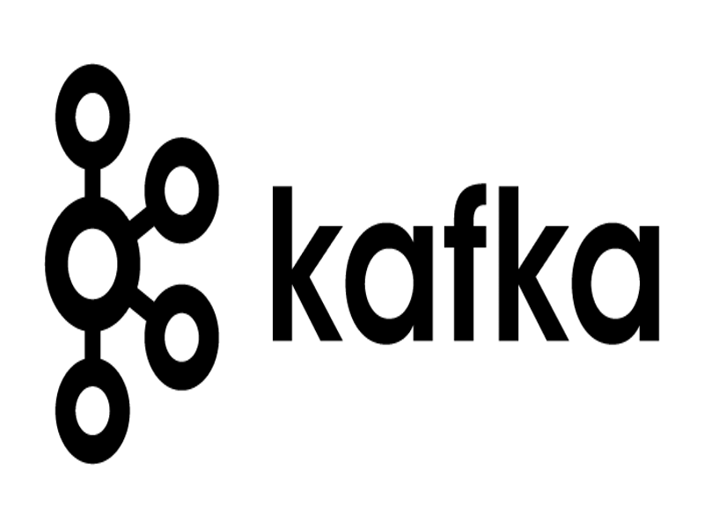


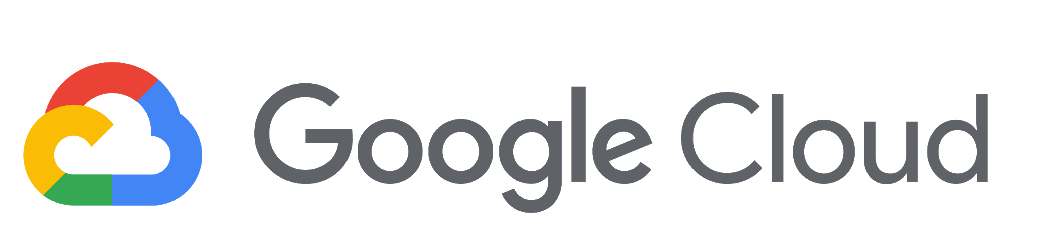
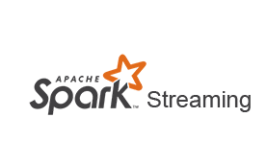




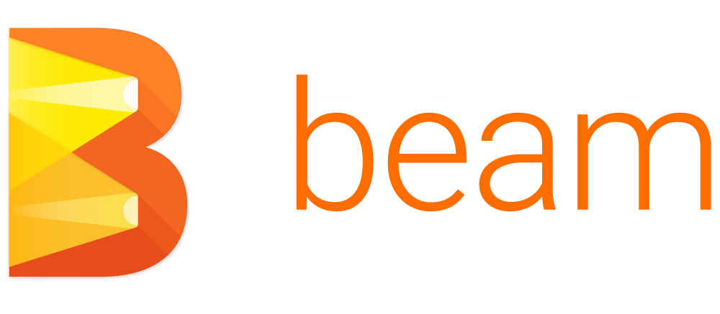


Next up...
Session 2
SQL & NoSQL
Session 3
Spark
Session 4
AI Platform
Session 5
Streaming
Session 6
Cloud
ML
Serverless
AI Platform
GCP PubSub
SQL
Notes:
Use Finance
Use Case for streaming asset data from a market data provider into trading and analytic systems
Live streaming data via a simple API. Published live market data from Thomson Reuters onto Pub/Sub
Consuming almost 1,000 assets from Reuters
Used Dataflow to help manage a distributed stream calculation engine
Put data into time-series windows to perform analysis
Ran correlations at regular time-intervals
About million correlations at a given time for calculation
No problem scaling to meet data demands
Wrote results to BigQuery and Pub/Sub for consumers
Traders utilized the trading system consuming the data to make decisions
Data Analysts would analyze trends over time in Tableau and Datalab

Slide 4

Hadoop 101
Distributed Storage (HDFS - Hadoop Distributed File System)
Distributed Compute
Any format (unstructured, structured, image, video, etc.)
Hadoop
Server 1
Server 2
Server 3
Server N
…

Slide 5
SQL vs NoSQL
SQL
[MySQL, Postgres, BigQuery, Oracle, etc.]
Relational databases
Data stored in tables (tabular)
Requires schema
Mostly vertically scalable
Generally better for multi-row transactions
Best for heavy transactional workloads
Uses SQL standard languages for queries
NoSQL
[HBase, Cassandra, MongoDB, Firestore, etc.]
Unstructured format
Non-relational database
Does not require a schema
Easily scalable and distributed
Horizontally scalable
Low-latency scans and lookups
Best for cases where query path is well defined
Query language not as standardized and syntax is specific to DB.

Slide 6





Interacting with Data in Hadoop
Data
Processing
SQL
NoSQL
Data
Storage
HDFS File System

Slide 7

Apache Hive
Defacto standard for SQL on Hadoop
Facebook open sourced Hive in 2008
Hadoop started in 2006
Hadoop achieved top-level Apache status in 2008
Hive is both a SQL-like language and a data store on Hadoop:
SQL-based language (HiveQL)
Hive is similar to a relational DB (familiar DB and table relationship)
Based on the SQL-92 specification
ODBC/JDBC APIs

Slide 8

Apache Hive at Scale
The original developers of Hive
More data than existing RDBMS could handle
300+ PB of data under management - in ORC *
600+ TB of data loaded daily
60,000+ Hive queries per day.
More than 1,000 users per day.

Slide 9
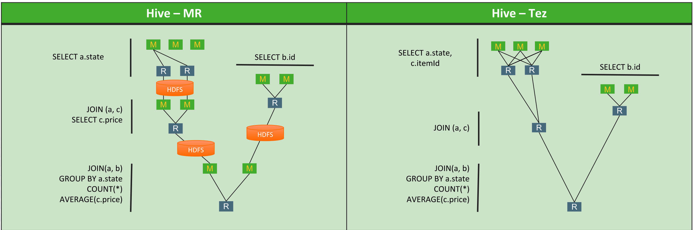
Apache Hive (MapReduce vs Tez)
SELECT a.state, COUNT(*), AVERAGE(c.price)
FROM a
JOIN b ON (a.id = b.id)
JOIN c ON (a.itemId = c.itemId)
GROUP BY a.state
Tez avoids unneeded writes to HDFS

Slide 10
Apache Hive - Example
CREATE TABLE IF NOT EXISTS mm_season
(id string, season string, day string, wteam string, wscore int, lteam string, lscore int, wloc string, ot string)
ROW FORMAT DELIMITED
FIELDS TERMINATED BY ","
LINES TERMINATED BY "\n"
STORED AS ORC;
INSERT OVERWRITE TABLE mm_season
SELECT * FROM mm_season LIMIT 10;
SELECT COUNT(*) FROM mm_season;
DESCRIBE mm_season;

Slide 11

Apache Phoenix (on HBase)
SQL interface on top of No-SQL (HBase)
Apache HBase provides random, real time access to data in Hadoop
Full ACID transaction capabilities
Dynamic Columns
Support secondary indexes
ODBC/JDBC APIs
Top-Level Apache Project (May 2014)
Open-sourced by Salesforce
Phoenix (SQL)
HBase
(NoSQL)

Slide 12
SQL layer on NoSQL so you can write SQL

Slide 13






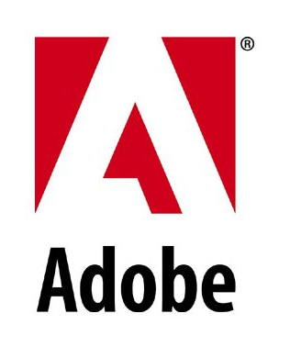
Apache Phoenix
Apps built on HBase
Sensor /
Device
Messaging
Time Series
Audit /
Log Archive
Search /
Indexing
Data Cubes
Advertising
Write Heavy Low-Latency

Slide 14
Apache Phoenix - Example
CREATE TABLE IF NOT EXISTS mm_season
(id VARCHAR, season VARCHAR, day VARCHAR, wteam VARCHAR, wscore INTEGER, lteam VARCHAR,
lscore INTEGER, wloc VARCHAR, ot VARCHAR
CONSTRAINT mypk PRIMARY KEY (id))
SALT_BUCKETS = 1;
HADOOP_CLASSPATH=/usr/hdp/2.5.0.0-1245/hbase/lib/hbase-protocol.jar:/usr/hdp/2.5.0.0-1245/hbase/conf \
hadoop jar /usr/hdp/2.5.0.0-1245/phoenix/phoenix-4.7.0.2.5.0.0-1245-client.jar org.apache.phoenix.mapreduce.CsvBulkLoadTool \
--table mm_season \
--d ”," \
--ignore-errors \
--input /tmp/marchmadness/SeasonResults/SeasonResults.csv
SELECT * FROM MM_SEASON LIMIT 10;
!describe mm_season

Slide 15

Apache Spark
In-Memory compute for ETL, Analytics, and Machine Learning
Scala, Java, Python, and R APIs
Libraries:
SparkSQL
Spark Streaming & Structured Streaming
GraphX
Spark ML

Slide 16
Apache SparkSQL - Example
mm_season = spark.read.load(
"hdfs://sandbox.hortonworks.com:8020/tmp/marchmadness/SeasonResults/SeasonResults.csv",
format="csv",
header=True)
mm_season.show()
mm_season.count()
mm_season.dtypes
mm_season.createOrReplaceTempView('mm_season_sql')
spark.sql('''SELECT * FROM mm_season_sql ''').show(10)

Slide 17



Which Technology should I use?
Defacto SQL on Hadoop (Production-ready, easy to get up and running)
Traditional SQL use cases (large-scale ETL, data prep)
Interactive Queries and Data Exploration
NoSQL schema required
Quick Scans / Lookups
Insert, update, and transactional support (full ACID capabilities)
Data science use cases
Multi-language support (Python, Java, Scala, R, scripting vs SQL preference)
High memory, low disk consumption
Real-time Use Cases
...and, they all integrate...

Slide 18
Managed SQL Databases

Slide 19
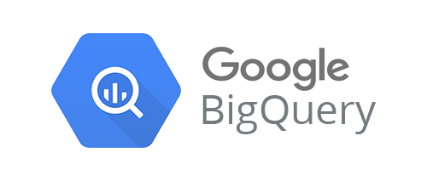
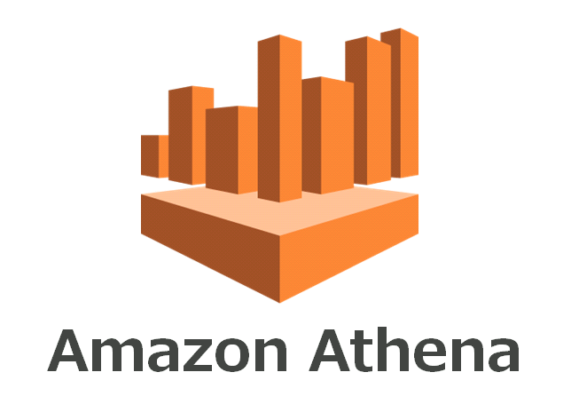
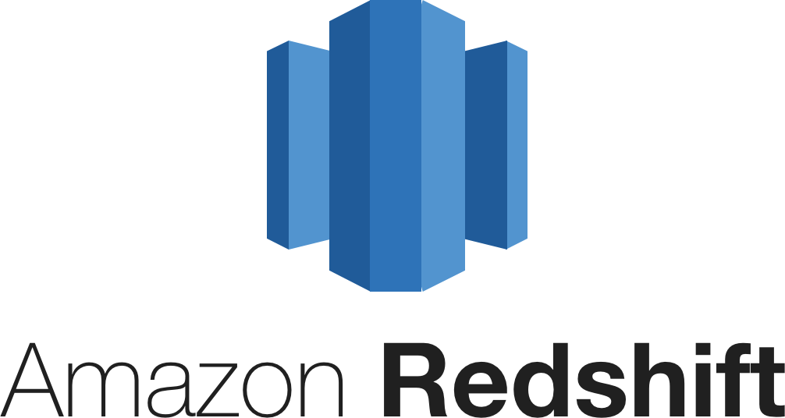
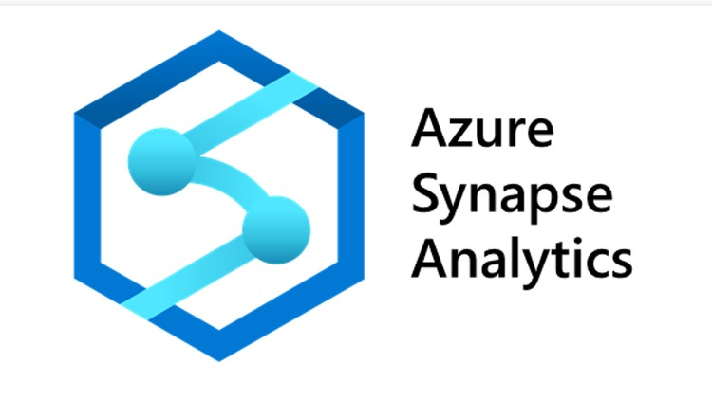


Slide 20
What is BigQuery?
Fully Managed, Zero-Ops Data Warehouse
Petabyte-Scale
Industry-Standard SQL
Automatically Encrypted, Durable, and Highly Available
Virtually Unlimited Resources
Notes:
Add the points of what fully managed means
Don’t have to worry about georeplication
Petabyte-Scale, but also sale that doesn’t cause any disruption or downtime. Still only pay for what you use.
Talk track here:
- Cite lloyds' bank study.. a couple of weeks to start getting value ..96 hours to 30 minutes..
- Cite the fact that the likes of Twitter and Pinterest take a minimum of 6-12 months to get their big data projects going
- Compare technological competency of Lloyd's to Twitters.. Lloyds is doing better engineering work than Twitter because they are partnering with google on innovation.
This is why fully-managed and no-ops are important

Slide 21
BigQuery | Serverless data warehouse
Traditional data warehouses
BigQuery’s serverless analytics
15% time > Analysis and insights
100% time on Analysis and insights
Monitoring
Performance tuning
Resource provisioning
Utilization improvements
Handling growing scale
Deployment & configuration
Reliability
Notes:
BigQuery eliminates the need of systems engineering from the data analytics workflow so that you can focus on data analysis.

Slide 22
Some BigQuery Stats
10.5 Trillion
Largest query (rows)
5 petabytes
Largest query (data size)
250 petabytes
Largest storage customer
4.5 million rows/sec
Peak ingestion rate
Notes:
And to give you a sense of what’s possible with these tools - here are some fun stats for BigQuery.

Slide 23
BigQuery | Architecture
Decoupled storage and compute for maximum flexibility
Client libraries for: C#, Go, Java, Node.js, PHP, Python, Ruby
Replicated, Distributed Storage
(99.9999999999% durability)
BigQuery
High-Available Cluster Compute
(Dremel)
SQL:2011
Compliant
Streaming Ingest
REST API
Distributed Memory Shuffle Tier
Web UI, CLI
Free Bulk
Loading
Petabit Network
Notes:
Google BigQuery is fully managed and serverless. Storage and compute are decoupled and can scale independently on-demand. This offers immense flexibility and cost control for your business as you don’t need to keep your expensive compute resources up and running all the time. This is very different than the traditional node based cloud data warehouse solutions or on premise MPP systems.
A technical deep dive article from Tino Tereshko on BigQuery -
https://medium.com/google-cloud/the-12-components-of-google-bigquery-c2b49829a7c7

Slide 24
BigQuery | Storage
High performance and cost optimized storage
Traditional RDBMS storage
BigQuery columnar storage
Notes:
BigQuery stores data in columns.
Most queries only work on a small number of fields and BigQuery only needs to read those relevant columns to execute a query. Since each column has data of same type, BigQuery could compress the column data much more effectively.
We make it easy to read a column and do scan, filter aggregate.
This is why queries cost on the column rather
Data within a column is more alike than data within a row
Row storage might be better for transacitonal where you are doing all sorts of updates and deletes
That’s why BQ is fundamentally about analysis not transactions

Slide 25
BigQuery | Managed Durability
Durable and persistent storage with automatic backup
Each table is compressed and encrypted on disk
Storage is durable & each table is replicated across datacenters
Table 1
Table 2
Table 3
Region
2
2
3
3
1
1
2
1
3
Zone A
Zone B
Zone C
Notes:
BigQuery offers a durable and persistent storage for your data warehouse. This helps you to simply data operations dramatically. Data is compressed and encrypted by default. You need not need to worry about data replication and DR as the data is automatically replicated across data centres.

Slide 26
Performance Optimization

Slide 27
How do you optimize queries
Less work → Faster Query
What is work for a query?
I/O — How many bytes did you read?
Shuffle — How many bytes did you pass to the next stage?
Grouping — How many bytes do you pass to each group?
Materialization — How many bytes did you write?
CPU work — User-defined functions (UDFs), functions

Slide 28
Don’t project unnecessary columns
On how many columns are you operating?
Excess columns incur wasted I/O and materialization
Don’t SELECT * unless you need every field
Notes:
Don’t SELECT * unless you need every field

Slide 29
Filter early and often using WHERE clauses
On how many rows (or partitions) are you operating?
Excess rows incur “waste” similar to excess columns
Notes:
Don’t SELECT * unless you need every field

Slide 30
Do the biggest joins first
Joins — In what order are you merging data?
Avoid self-join if you can, since it squares the number of rows processed
Notes:
Often you can replace self-join by a group-by: http://weblogs.sqlteam.com/jeffs/archive/2007/06/12/using-group-by-to-avoi d-self-joins.aspx

Slide 31
Built-in functions are faster than JavaScript UDFs
Functions — What work are we doing on the data?
Guideline — Some operators are faster than others; all are faster than JavaScript® UDFs
Example — Exact COUNT(DISTINCT) is very costly, but APPROX_COUNT_DISTINCT is very fast
Note: Check to see if there are reasonable approximate functions for your query

Slide 32
Wildcard tables — Standard SQL (1 of 2)
Use wildcards to query multiple tables using concise SQL statements
Wildcard tables are a union of tables matching the wildcard expression
Useful if your dataset contains:
Multiple, similarly named tables with compatible schemas
Sharded tables
When you query, each row contains a special column with the wildcard match

Slide 33
Wildcard tables — Standard SQL (2 of 2)
Example:
SELECT * FROM `bigquery-public-data.noaa_gsod.gsod*`
Matches all tables in noaa_gsod that begin with string ‘gsod’
The backtick (``) is required
Richer prefixes perform better than shorter prefixes
For example: .gsod200* versus .*

Slide 34
Table Partitioning
Time-partitioned tables are a cost-effective way to manage data
Easier to write queries spanning time periods
When you create tables with time-based partitions, BigQuery automatically loads data in correct partition
Declare the table as partitioned at creation time using this flag: --time_partitioning_type
To create partitioned table with expiration time for data, using this flag: --time_partitioning_expiration

Slide 35
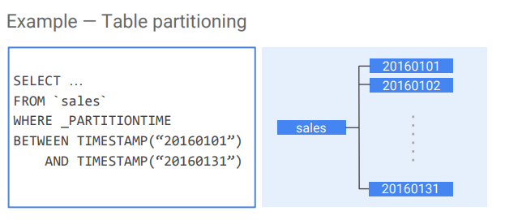
Example - Time Partitioning

Slide 36


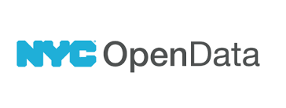


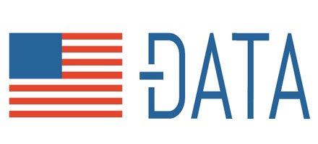










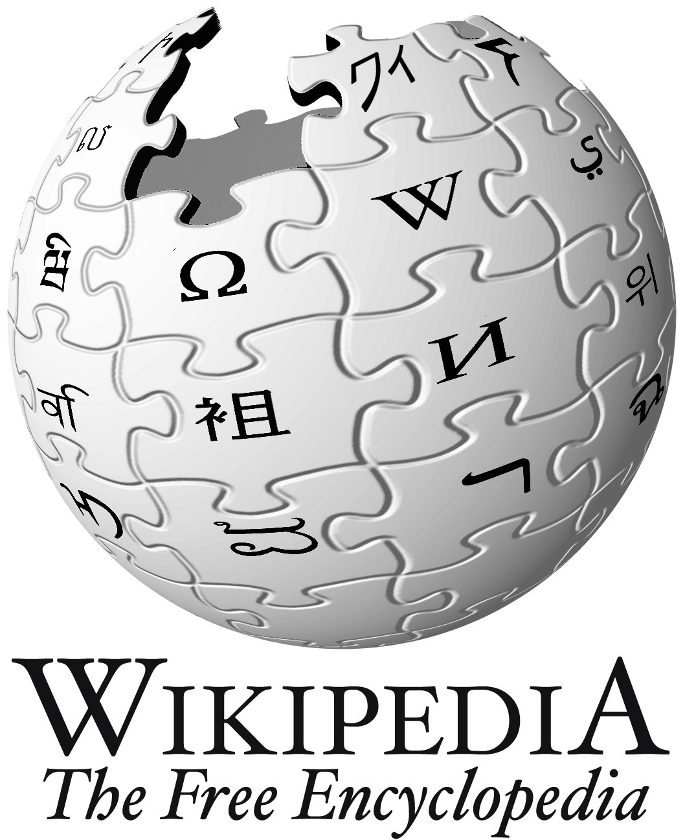



BigQuery Public Datasets

Slide 37











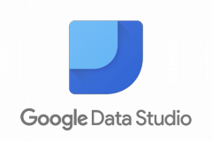

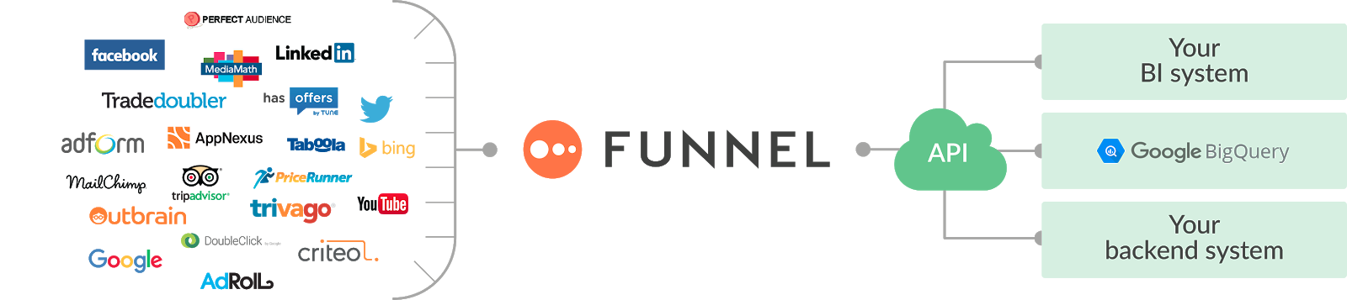
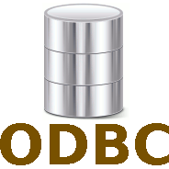
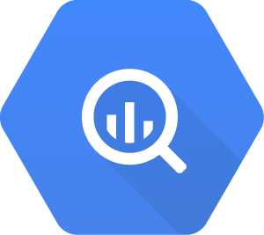

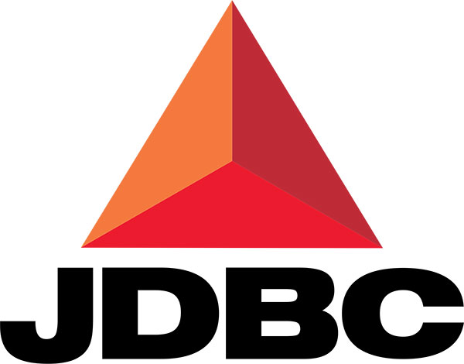



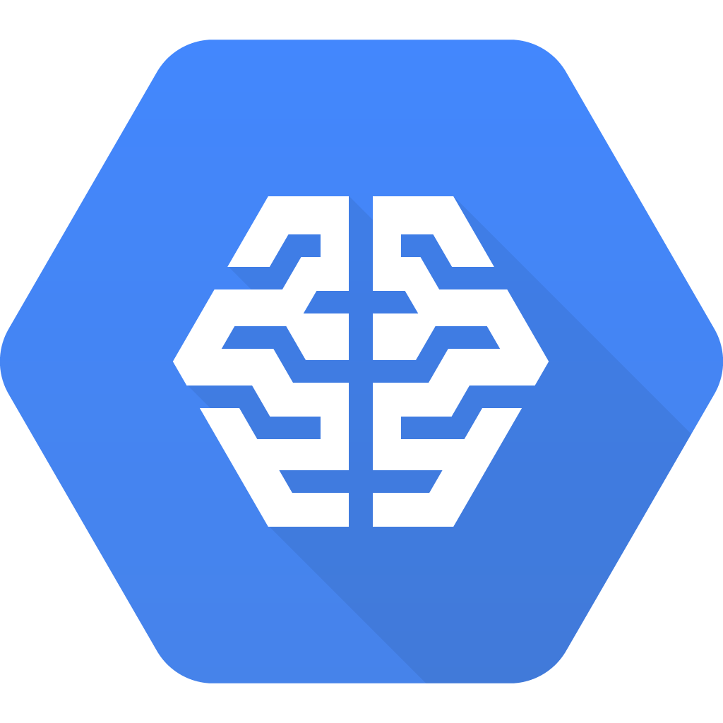


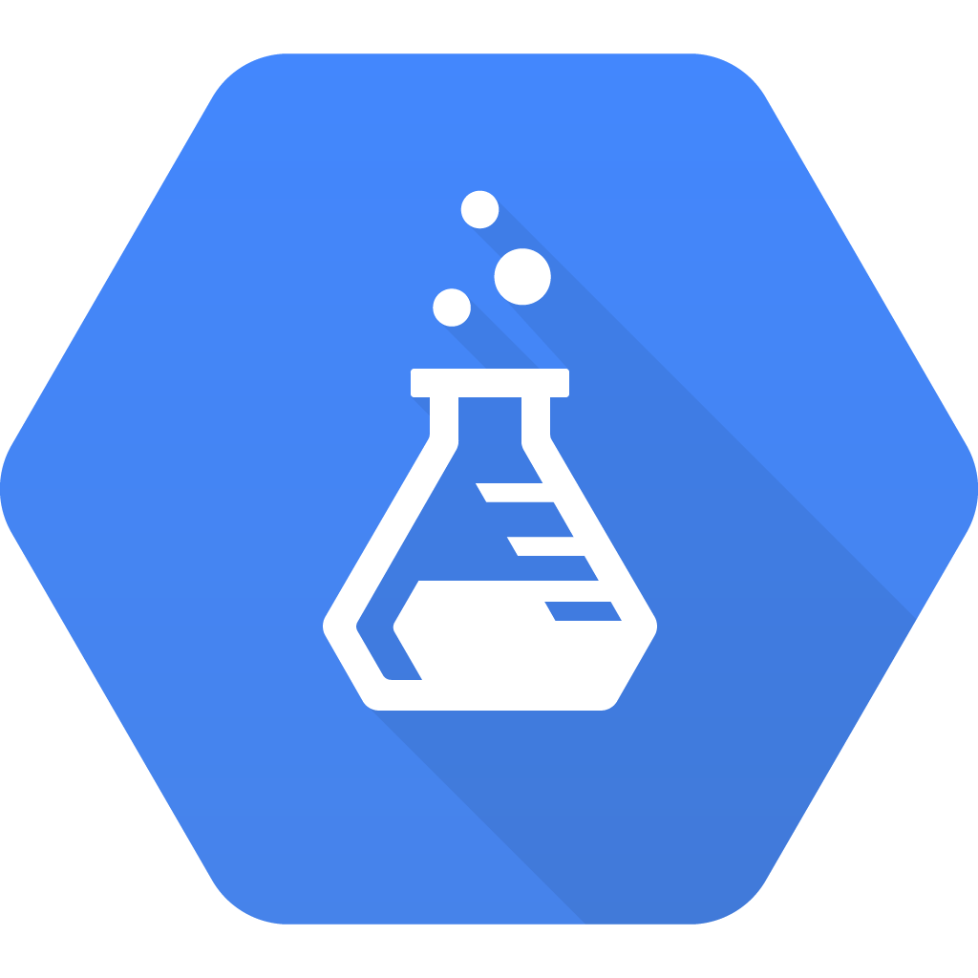
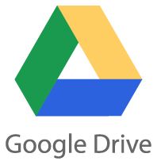



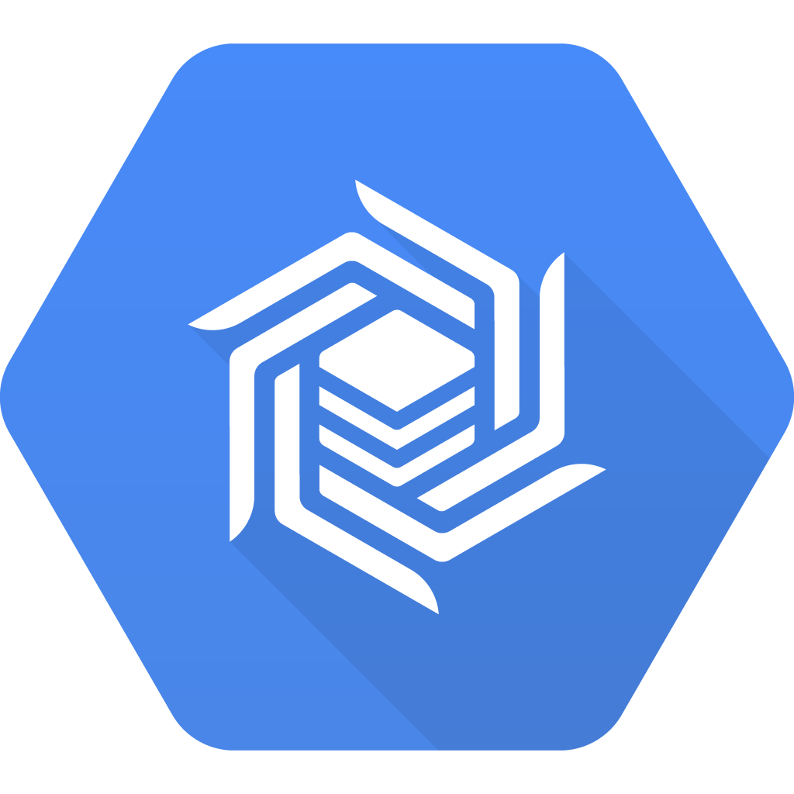

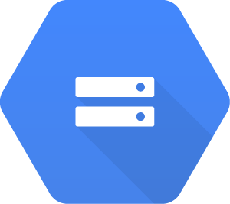
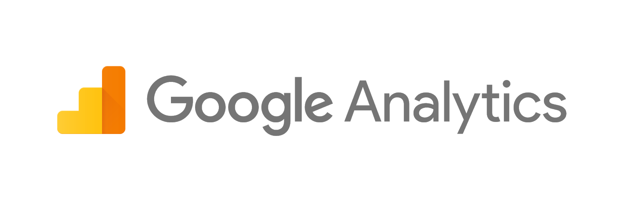
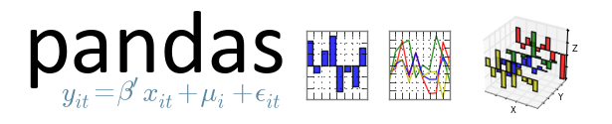


Integration with Partner Ecosystem
BI/Analytics Tools
Google Sheets
Publishers
Advertisers
Cloud Machine Learning
Cloud Datalab

Slide 38
NoSQL

Slide 39




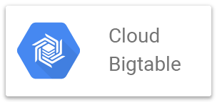
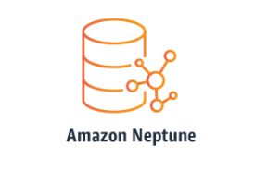


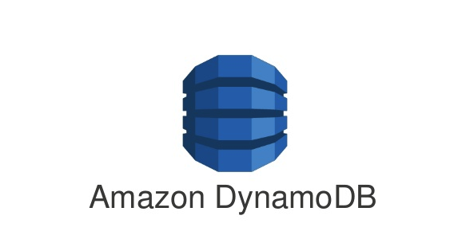
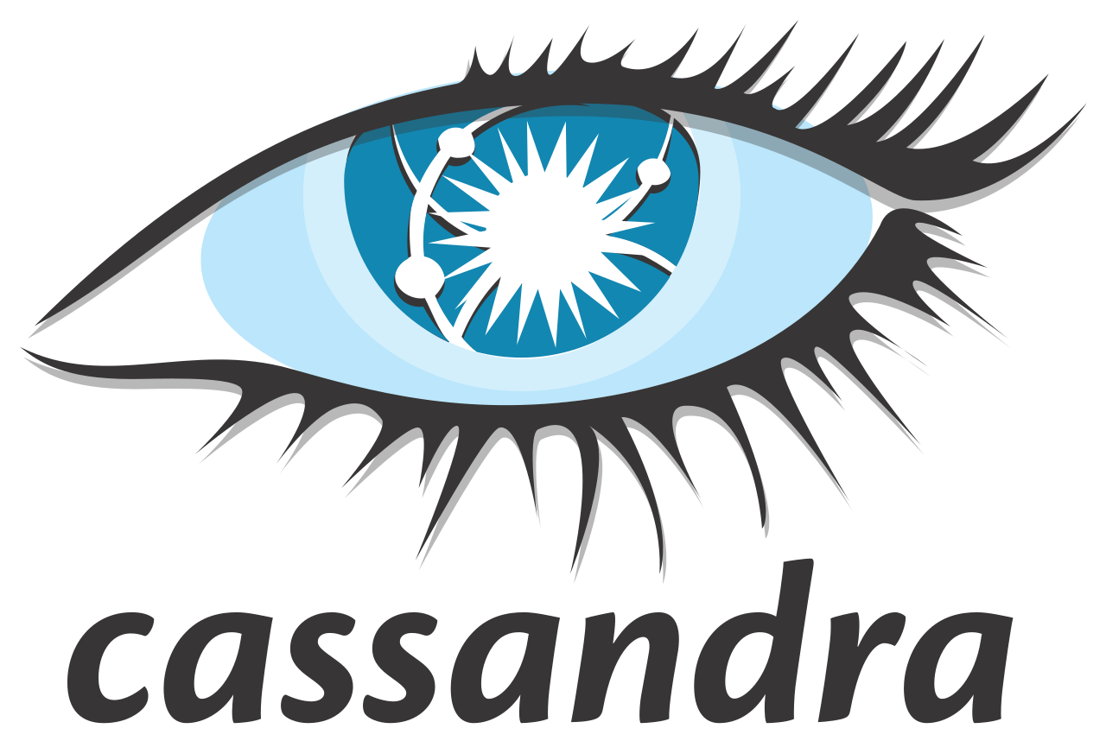

Types of NoSQL
Key-Value Stores
Column Oriented
Document DBs
Graph DBs
Titan
NOTE: NoSQL Database can span across multiple categories. This slide is just intended for example purpose.
Notes:
Well of course not! We've been busy. For all of you app developers out there, we built Cloud Firestore as our next-generation database to store and synchronize app data at a global scale. We launched into Beta in 2017 and GA in early 2019.
This is the second serverless database that we've built. We've learned a lot from our work on the Realtime Database over the past several years, and we incorporated many of these lessons into Cloud Firestore. We think this makes for a compelling and powerful product, and we encourage you to look at Cloud Firestore as your database for any new mobile or web applications you're building.

Slide 40
Notes:
Well of course not! We've been busy. For all of you app developers out there, we built Cloud Firestore as our next-generation database to store and synchronize app data at a global scale. We launched into Beta in 2017 and GA in early 2019.
This is the second serverless database that we've built. We've learned a lot from our work on the Realtime Database over the past several years, and we incorporated many of these lessons into Cloud Firestore. We think this makes for a compelling and powerful product, and we encourage you to look at Cloud Firestore as your database for any new mobile or web applications you're building.

Slide 41
Example Firestore Document
bird_type:
airspeed:
coconut_capacity:
isNative:
icon:
vector:
distances_traveled:
"swallow"
42.733
0.62
false
<binary data>
{x: 36.4255,
y: 25.1442,
z: 18.8816
[42, 39, 12, 42]
Notes:
Cloud Firestore is a Document-model database. All of your data is stored in “documents” and then “collections”.
Let’s look at a document first. You can think of a document as something like a dictionary, or a hash. It looks like JSON but it's more powerful.
{CLICK} It's got a set of key-value pairs, which we like to refer to as “fields”.
{CLICK} And the values for the fields can be a number of different types -- anything from strings, to numbers, to binary values, to JSON-like sub objects that the team likes to refer to as maps.

Slide 42
Collection
Notes:
Now these documents are stored in collections. These are -- as you might suspect -- collections of documents. Note that documents can't directly contain other documents, {CLICK} but they can point to subcollections that contain other documents, which can point to subcollections, and so on.
This structure brings with it a number of advantages. For starters, all queries that you make are shallow {CLICK} meaning that you can grab a document without worrying about grabbing all the data underneath it. And this means that you can structure your data hierarchically in a way that makes sense to you logically, without having to worry about grabbing tons of unnecessary data.

Slide 43




collection("restaurants").
where("city", "==", "Cairo").
orderBy("rating", "desc").limit(10)
Here ya go!
Notes:
Cloud Firestore also makes it much easier to run queries that span multiple fields in a document. In many NoSQL databases, including the Realtime Database, this was very difficult to do, and these searches required hacks or workarounds. In Cloud Firestore, we can do this work for you; either automatically, or by creating composite indexes to make these searches easier.
But perhaps most importantly, queries in Cloud Firestore scale with the size of the result set, not the size of your dataset. So fetching the top 10 restaurants in Cairo with your restaurant app will take the same amount of time whether you have 500 documents to look through, {CLICK} or 500 million. So your app stays blazingly fast, no matter how much data it has.

Slide 44
Features
Cloud Datastore
✕ Not serverless
✕ Not real-time
✕ No offline support
~ Inconsistent queries
✓ Multi-region replication
✓ Planetary scale
Firebase Realtime Database
✓ Serverless
✓ Real-time
~ Offline (iOS, Android only)
~ Limited queries
✕ No multi-region replication
✕ Doesn’t scale to large apps
Cloud Firestore
✓ Serverless
✓ Real-time
✓ Offline (iOS, Android, Web)
✓ Powerful, consistent queries
✓ Multi-region replication
✓ Planetary scale
Notes:
Cloud Firestore combines the power and scalability of Datastore
with the serverless, realtime, offline magic of the Realtime Database.
It’s the successor to both products.

Slide 45




13 global locations
Locations (new regions bolded)
Regional
Multi-region
London
United States
Montreal
Europe
Tokyo
N. Virginia
Frankfurt
Los Angeles
Hong Kong
S. Carolina
Mumbai
São Paulo
Sydney
Asia Pacific
Americas
Europe, Middle East, & Africa
Notes:
Two multi-regions: North America and Europe
11 other regional locations
More on the way

Slide 46
// (1) Root collection
db.collection('posts')
.where('user_id', '==','abc123').get()
// (2) Subcollection
db.collection('users')
.doc('abc123')
.collection('posts').get()
Notes:
Here's a simple example where we can show the two options and how it affects data access.
So you can see that if you store things in a root-level collection, you have to use a query to get them back out. In a subcollection, it's just a direct get() operation on a path, no where() clause.
Now in Cloud Firestore these two operations are the same speed, so there is no performance difference. It's more about organization.
In the first case, you have all the user posts sort of lumped together and you have to add a property to each. But in the second example, you know where all the user posts are without any extra properties.

Slide 47
// Multiple where '==' clauses
// NO PROBLEM
db.collection('restaurants')
.where('category', '==' 'tacos')
.where('price', '==', 2)
.where('city', '==', 'Berlin')
.get()
Notes:
Ok so let's look at a basic query in Cloud Firestore.
This query has a lot of "where x equals y" clauses. And this is no problem, Cloud Firestore can handle this and make it fast.
If you ever developed with Realtime Database, you know this kind of compound query was not possible.

Slide 48
// Some '==' clauses and one range?
// NO PROBLEM
db.collection('restaurants')
.where('category', '==' 'tacos')
.where('price', '>', 1)
.get()
Notes:
Now let's look at something a little more advanced. Here we have one equality clause (the category must be 'tacos') but then also one range clause, looking for price greater than '1'.
This is also not a problem in Cloud Firestore, but it is actually more complex to serve than the previous example where everything was about equality, not order.

Slide 49
// Multiple range clauses
// UH OH - NOT ALLOWED
db.collection('restaurants')
.where('rating', '>', 4.7)
.where('price', '>' , 1)
.get()
Notes:
Now here's something that might not look more complex, but it is. We have ranges on both the restaurant rating and price.
We can't do this! You simply cannot have more than one range clause (on different fields) in Cloud Firestore. So what's the deal? Why can't we do this? Well let's back up for a second and talk about indexes.

Slide 50
Assignment

Slide 51
SQL & NoSQL Assignments
SQL Assignment - Please complete this as an individual assignment and upload your code as a notebook file, script, google doc, etc.
NoSQL Assignment - Please complete this as an individual assignment and upload your code as a notebook file, script, google doc, etc.
Due Date: Friday, March 26, 2021
Email with any questions: d.zaratsian@gmail.com

Slide 52
Google BigQuery Sandbox Environment
https://console.cloud.google.com/bigquery

Slide 53
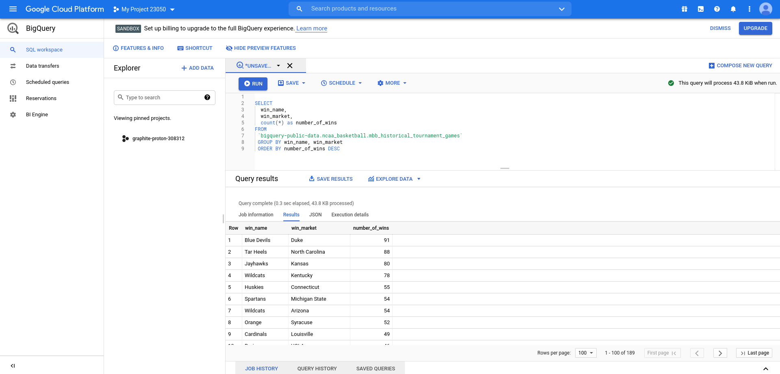

Slide 54

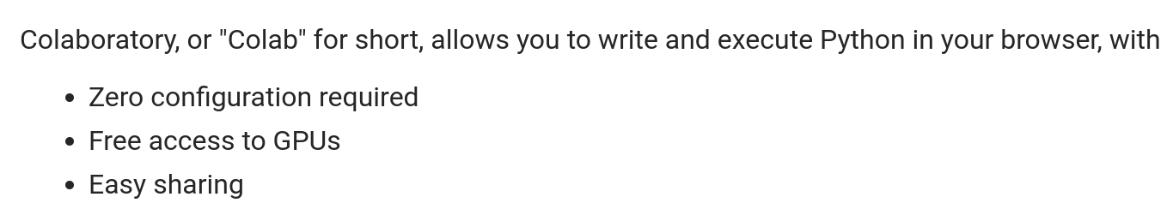
https://colab.sandbox.google.com/

Slide 55
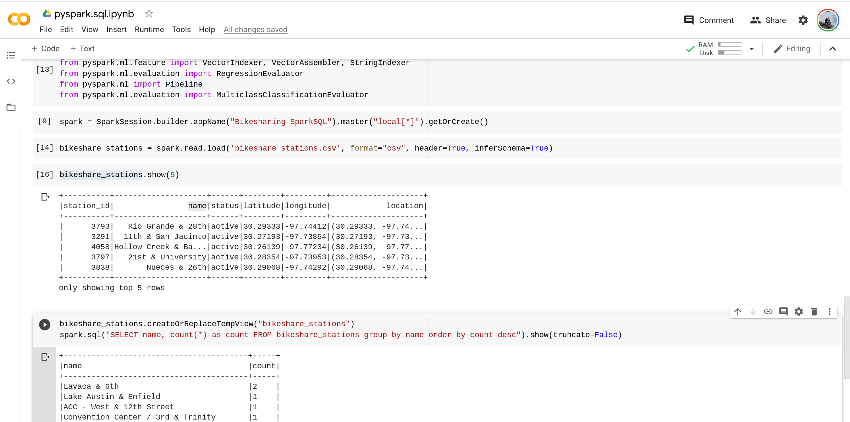

Slide 56
Advanced Big Data
Thanks!
Dan Zaratsian
AI & Machine Learning Engineer @ Google
d.zaratsian@gmail.com
https://github.com/zaratsian

